Slide 1

Chapter 9
Object-Oriented Design and High-Level Programming Languages

Slide 2
Chapter Goals (1 of 3)
Distinguish between functional design and object-oriented design
Describe the stages of the object-oriented design process
Apply the object-oriented design process
Name, describe, and give examples of the three essential ingredients of an object-oriented language

Slide 3
Chapter Goals (2 of 3)
Describe the translation process and distinguish among assembly, compilation, interpretation, and execution
Name four distinct programming paradigms and name a language characteristic of each
Define the concepts of a data type and strong typing

Slide 4
Chapter Goals (3 of 3)
Understand how the constructs of top-down and object-oriented design are implemented in programming languages

Slide 5
Object-Oriented Design (1 of 10)
Object-Oriented Design
A problem-solving methodology that produces a solution to a problem in terms of self-contained entities called objects
Object
A thing or entity that makes sense within the context of the problem
For example, a student, car, time, date

Slide 6
Object-Oriented Design (2 of 10)
World View of OOD
Problems are solved by:
Isolating the objects in a problem,
Determining their properties and actions (responsibilities), and
Letting the objects collaborate to solve a problem

Slide 7
Object-Oriented Design (3 of 10)
An analogy: You and your friend fix dinner
Objects: You, friend, dinner
Class: You and friend are people
People have name, eye color, …
People can shop, cook, …
Instance of a Class: You and friend are instances of class People, you each have your own name and eye color, you each can shop and cook
You collaborate to fix dinner

Slide 8
Object-Oriented Design (4 of 10)
Class (or object class)
A description of a group of similar objects
Object (instance of a class)
A concrete example of the class
Classes contain fields that represent the properties (name, eye color) and behaviors (responsibilities) (shop, cook) of the class
Method
A named algorithm that defines behavior (shop, cook)

Slide 9
Object-Oriented Design (5 of 10)
Top-Down Design
Decomposes problems into tasks
Object-Oriented Design
Decomposes problems into collaborating objects
Yes, but how?

Slide 10
Object-Oriented Design (6 of 10)
Steps
Isolate the real-world objects in the problem
Abstract the objects with like properties into groups (classes)
Determine the responsibilities of the group in interacting with other groups

Slide 11
Object-Oriented Design (7 of 10)
Think of design as a mapping from real world objects to classes of objects
birthdate
Date class
marriage
date
dog's
birthdate
Objects Classes of objects

Slide 12
Object-Oriented Design (8 of 10)
Program World simulates these groups
dogBirthdate
class Date
birthdate
marriageDate
Description Instances

Slide 13
Object-Oriented Design (9 of 10)
Date's
actions in
real world
?
We call an object's interactions
with other objects its
responsibilities
Create itself
Know the state of its fields
Compare itself to another date
Return a date a number of days hence

Slide 14
Object-Oriented Design (10 of 10)
Responsibilities become methods in the Program World
dogBirthdate
class Date
getMonth
getDay
getYear
birthdate
marriageDate

Slide 15
Object-Oriented Design Methodology
Four stages to the decomposition process
Brainstorming to locate possible classes
Filtering the classes to find duplicates or remove unnecessary ones
Scenarios are tried to be sure we understand collaborations
Responsibility algorithms are designed for all actions that classes must exhibit

Slide 16
Brainstorming
A group problem-solving technique that involves the spontaneous contribution of ideas from all members of the group
All ideas are potential good ideas
Think fast and furiously first, and ponder later
A little humor can be a powerful force
Brainstorming is designed to produce a list of candidate classes

Slide 17
Filtering
Determine which are the core classes in the problem solution
There may be two classes in the list that have many common attributes and behaviors
There may be classes that really don't belong in the problem solution

Slide 18
Scenarios (1 of 2)
Assign responsibilities to each class
There are two types of responsibilities:
What a class must know about itself (knowledge responsibilities)
What a class must be able to do (behavior responsibilities)

Slide 19
Scenarios (2 of 2)
Encapsulation
The bundling of data and actions in such a way that the logical properties of the data and actions are separated from the implementation details
Each class encapsulates its data but shares their values through knowledge responsibilities

Slide 20
Responsibility Algorithms (1 of 3)
The algorithms must be written for the responsibilities:
Knowledge responsibilities usually just return the contents of one of an object's variables
Action responsibilities are a little more complicated, often involving calculations

Slide 21
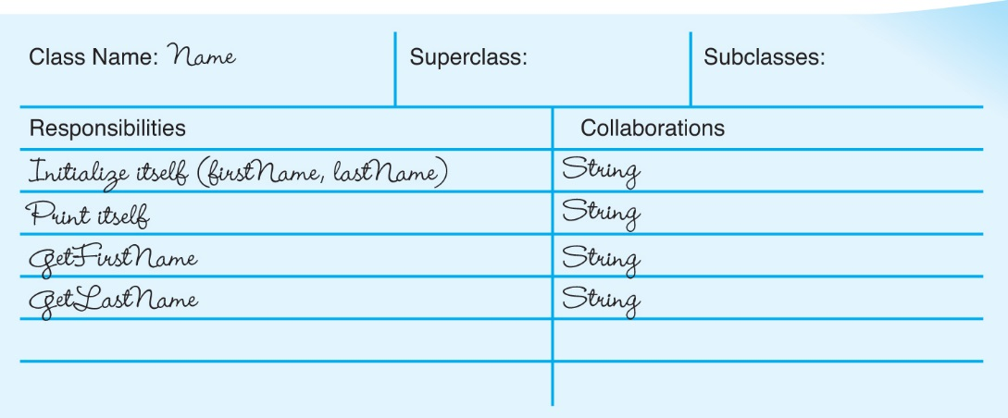
CRC Cards (1 of 4)
CRC cards are a notational device to record information
about a class, what it must do, and with whom it must
collaborate

Slide 22
Computer Example
Let's examine the problem-solving process for creating an address list
Brainstorming and filtering
Circling the nouns and underlining the verbs is a good way to begin

Slide 23
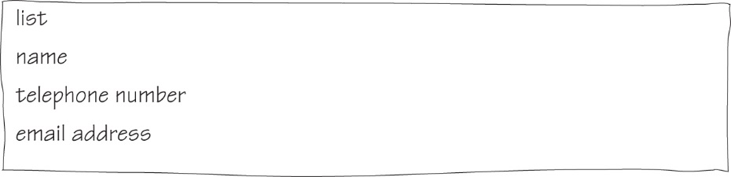
CRC Cards (2 of 4)
Can you think of any other useful responsibilities?

Slide 24
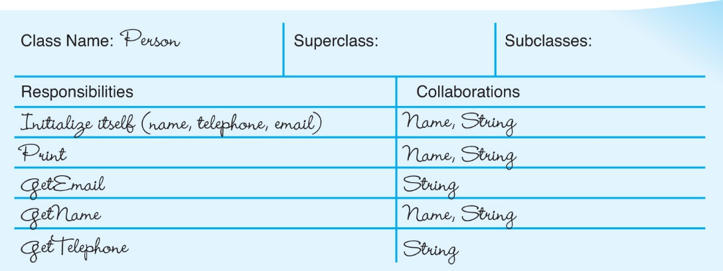
CRC Cards (3 of 4)
Can you think of any other useful responsibilities?

Slide 25
CRC Cards (4 of 4)
How is this class different from Name and Person?

Slide 26
Responsibility Algorithms (2 of 3)
Person Class
Initialize
name.initialize()
Write "Enter phone number; press return."
Get telephone number
Write "Enter email address; press return."
Get email address
Print
name.print()
Write "Telephone number: " + telephoneNumber
Write "Email address: " + emailAddress
Tells name to initialize itself
Tells name to print itself

Slide 27
Responsibility Algorithms (3 of 3)
Name Class
Initialize
"Enter the first name; press return."
Read firstName
"Enter the last name; press return."
Read lastName
Print
Print "First name: " + firstName
Print "Last name: " + lastName

Slide 28
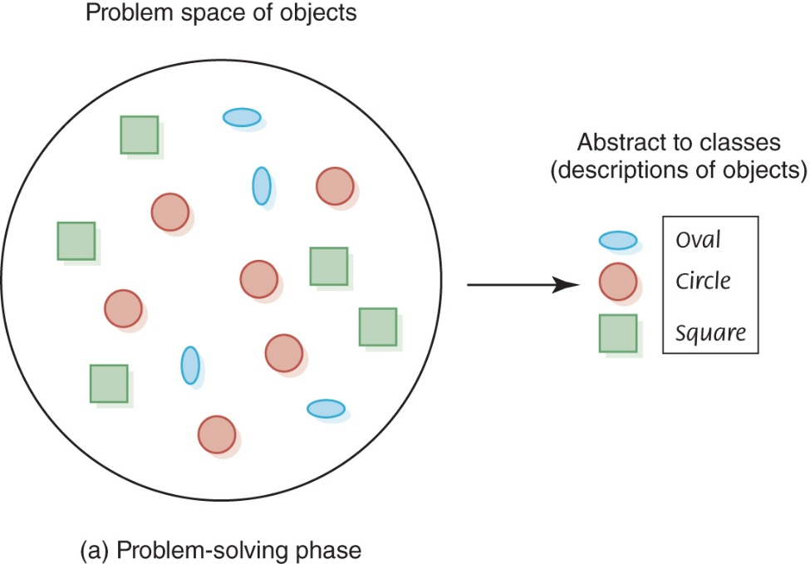
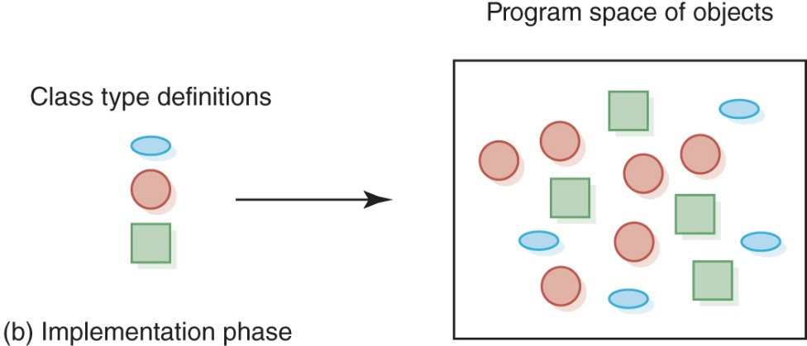
Object-Oriented Phases
Mapping of a problem into a solution

Slide 29
Translation Process
A program written in a high-level language must be translated into machine code
The machine code is then executed
Compilers and interpreters are software tools employed to help with the translation process

Slide 30
Compilers (1 of 2)
High-Level Language
A language that provides a richer (more English-like) set of instructions
Compiler
A program that translates a high-level language program into machine code

Slide 31
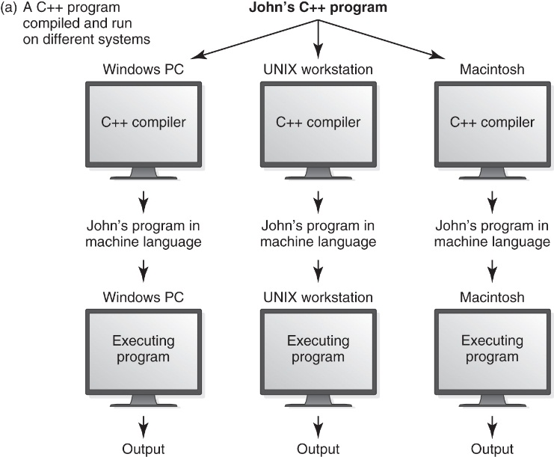
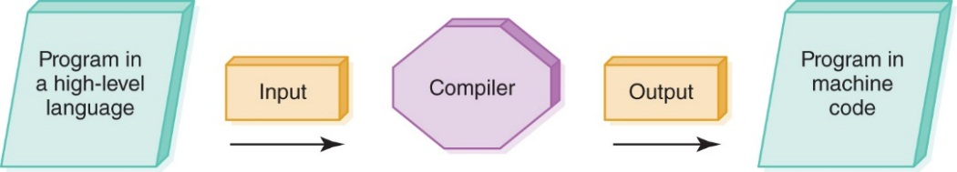
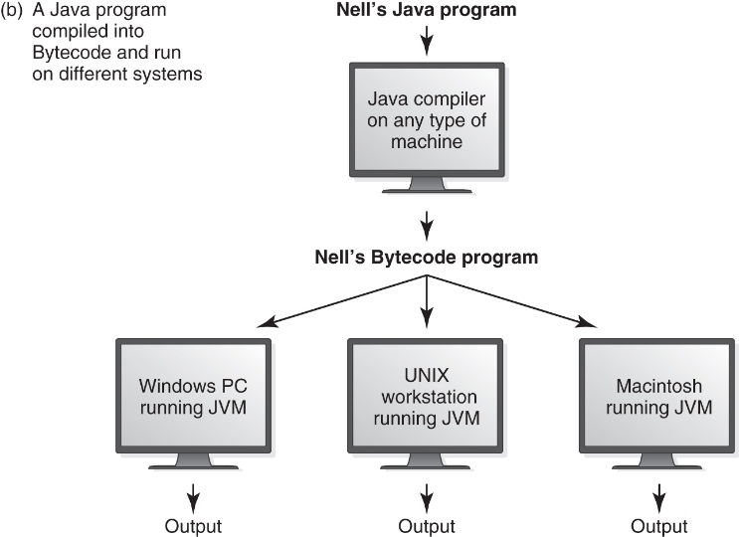
Compilers (2 of 2)
Compilation process
How does this differ from
the assembly process?
Portability improvement because of Bytecode interpretation

Slide 32
Interpreters
Interpreter
A translating program that translates and executes the statements in sequence
Assembler or compiler produce machine code as output, which is then executed in a separate step
An interpreter translates a statement and then immediately executes the statement
Interpreters can be viewed as simulators

Slide 33
Java
Introduced in 1996 and became instantly popular
Portability was of primary importance
Java is compiled into a standard machine language called Bytecode
A software interpreter called the JVM (Java Virtual Machine) takes the Bytecode program and executes it

Slide 34
Portability (1 of 3)
Portability
The ability of a program to be run on different machines
Compiler Portability
A program in a standardized language can be compiled
and run on any machine that has the appropriate compiler
Bytecode Portability
A program translated into Bytecode can be run on
any machine that has a JVM
Do you understand the difference?

Slide 35
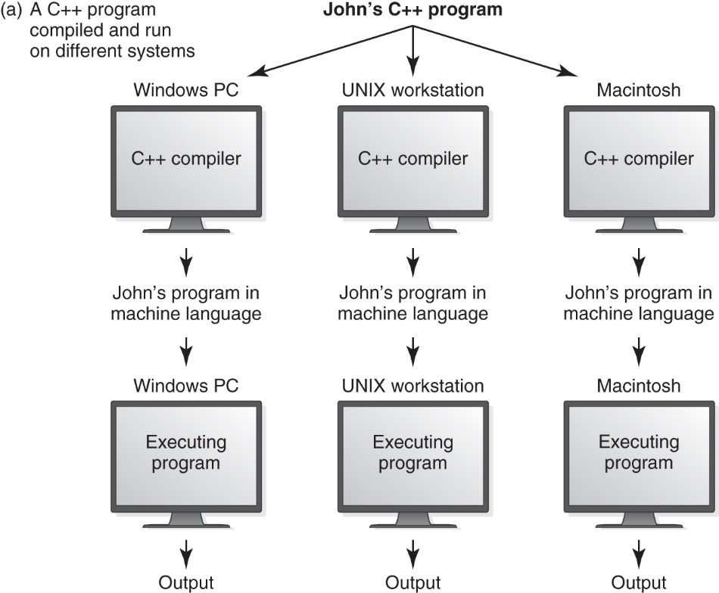
Portability (2 of 3)
Portability improvement because of Bytecode interpretation

Slide 36
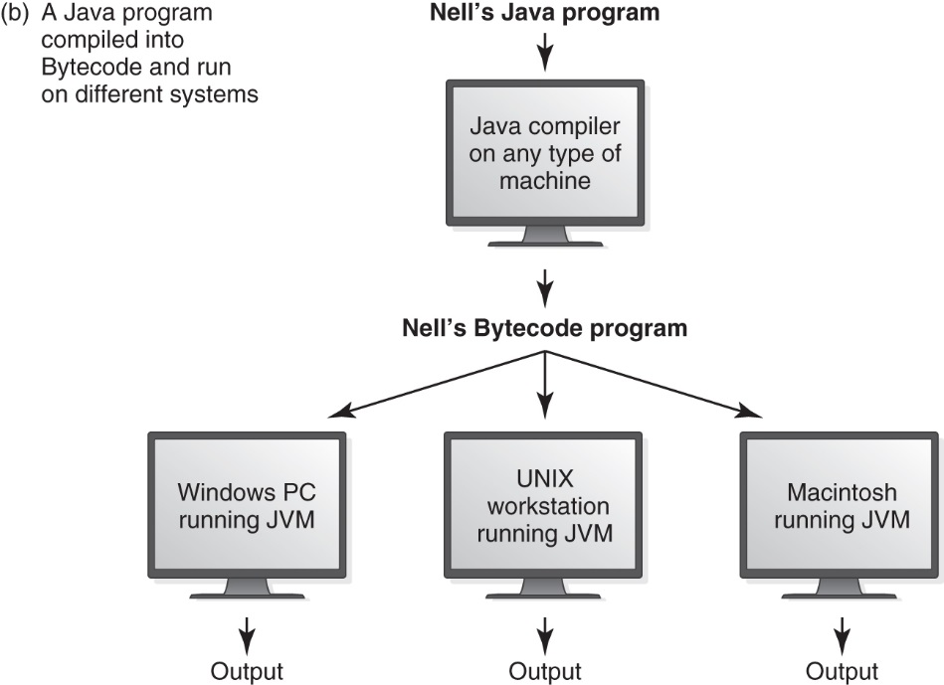
Portability (3 of 3)
Portability improvement because of Bytecode interpretation

Slide 37
Programming Language Paradigms (1 of 4)
Imperative Paradigm
Program describes the processing
Declarative Paradigm
Program describes the results
Each of these major paradigms have distinct subparadigms

Slide 38
Programming Language Paradigms (2 of 4)
Imperative
Procedural
Characterized by sequential instructions
A program in which statements are grouped into a hierarchy of subprograms
Fortran, C, C++
Object-oriented model
Program consists of a set of objects and the interactions among the objects
Python, Java, Smalltalk, Simula

Slide 39
Programming Language Paradigms (3 of 4)
C++ is a procedural language with some object-oriented features
Java is an object-oriented language with some procedural features
39
Notes:
39

Slide 40
Programming Language Paradigms (4 of 4)
Declarative
Functional
Based on the mathematical concept of a function
Lisp, Scheme, and ML
Logic
Based on principles of symbolic logic
Types of statements:
Declares facts about objects and relationships
Defines rules about objects
Asks questions about objects
PROLOG
40
Notes:
40

Slide 41
Scheme (1 of 2)
41
Notes:
41

Slide 42
Scheme (2 of 2)
#;> (define factorial
#;> (lambda(n)
#;> (if
#;> (= n 0)
#;> 1
#;> (* n (factorial (- n 1))))))
#;> (factorial 7)
5040
Compare to pseudocode algorithm
42
Notes:
42

Slide 43
PROLOG (1 of 2)
Pets to owners
owns(mary,bo).
owns(ann,kitty).
owns(bob,riley).
owns(susy,charlie).
?-owns(mary,bo)
yes
?-owns(bo,mary)
no
?-owns(susy,bo)
no
States
facts
Asks
questions
43
Notes:
43

Slide 44
PROLOG (2 of 2)
Uppercase is
variable;
lowercase
is constant
?-owns(ann, Cat).
Cat = kitty
?-owns(Name,charlie).
Name = susy
44
Notes:
44

Slide 45
Functionality of High-Level Languages
We examine procedural and object-oriented languages in the rest of this chapter by looking at the functionality provided in these languages
We give examples in different languages to show how syntax used to provide the functionality

Slide 46
Functionality of Imperative Languages
Sequence
Executing statements in sequence until an instruction is encountered that changes this sequencing
Selection
Deciding which action to take
Iteration (looping)
Repeating an action
Do these concepts sound familiar?
Let's review them.

Slide 47
Boolean Expressions (1 of 2)
Boolean Expression
A sequence of identifiers, separated by compatible operators, that evaluates to true or false
A Boolean expression can be:
A Boolean variable
An arithmetic expression followed by a relational operator followed by an arithmetic expression
A Boolean expression followed by a Boolean operator followed by a Boolean expression

Slide 48
Boolean Expressions (2 of 2)
Remember the relational operators?
List them!

Slide 49
Strong Typing
Data Type
A description of the set of values and the basic set of operations that can be applied to values of the type
Strong Typing
The requirement that only a value of the proper type can be stored into a variable

Slide 50
Data Types
Integer numbers
Real numbers
Characters
Boolean values
Strings
Give examples
of each.

Slide 51
Integers
What determines the range of an integer value?
Is the range of an integer value the same in all languages?
What operations can be applied to integers?

Slide 52
Reals
How are real values like integer values?
How do real values differ from integer values?

Slide 53
Characters
Do you remember:
ASCII?
Extended ASCII?
UNICODE?
How many characters in Extended ASCII?
How many characters in UNICODE mapping?
What does a relational operator between two characters mean?

Slide 54
Boolean and Strings
What values can a Boolean variable be?
For what are Boolean expressions used?
What is a string?
What operations can be applied to strings?

Slide 55
Declarations
Declaration
A statement that associates an identifier with a variable, an action, or some other entity within the language that can be given a name; the programmer can refer to that item by name
Reserved Word
A word in a language that has special meaning
Case-Sensitive
Uppercase and lowercase letters are considered the same

Slide 56
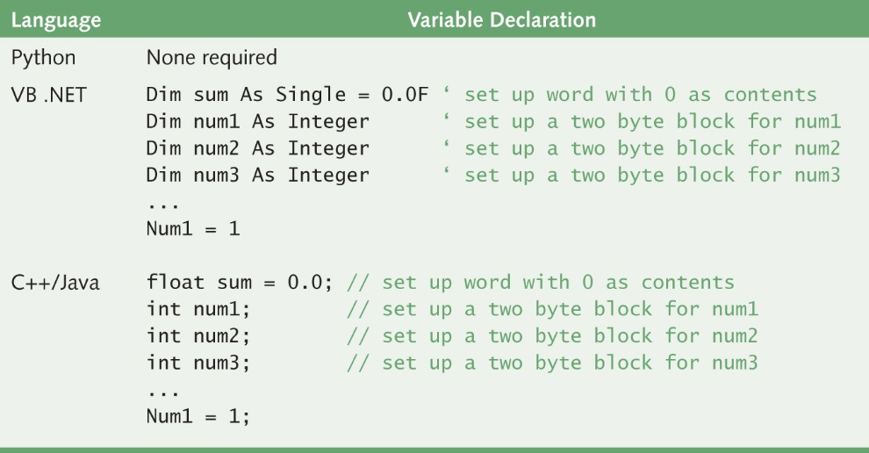
Declaration Example

Slide 57
Assignment Statement
Assignment Statement
An action statement (not a declaration) that says to evaluate the expression on the right-hand side of the symbol and store that value into the place named on the left-hand side
Named Constant
A location in memory, referenced by an identifier, that contains a data value that cannot be changed

Slide 58
Input/Output Structures (1 of 3)
Pseudocode algorithms used the expressions Read or Get and Write or Print
High-level languages view input data as a stream of characters divided into lines
Key to the Processing:
The data type determines how characters are to be converted to a bit pattern (input) and how a bit pattern is to be converted to characters (output)

Slide 59
Input/Output Structures (2 of 3)
Read name, age, hourlyWage
name is a string;
age is an integer;
hourlyWage is a real
The data must be a string, an integer, and a
real in that order.

Slide 60
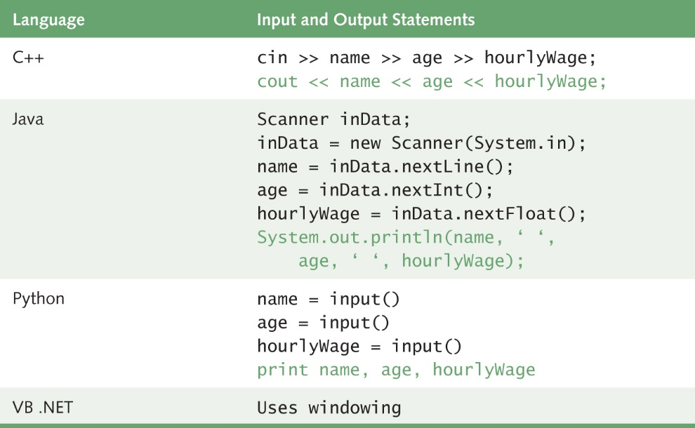
Input/Output Structures (3 of 3)
60
Notes:
60

Slide 61
Control Structures
Control Structures
Instructions that determine the order in which other instructions in a program are executed
Can you name the ones we defined in the functionality of pseudocode?

Slide 62
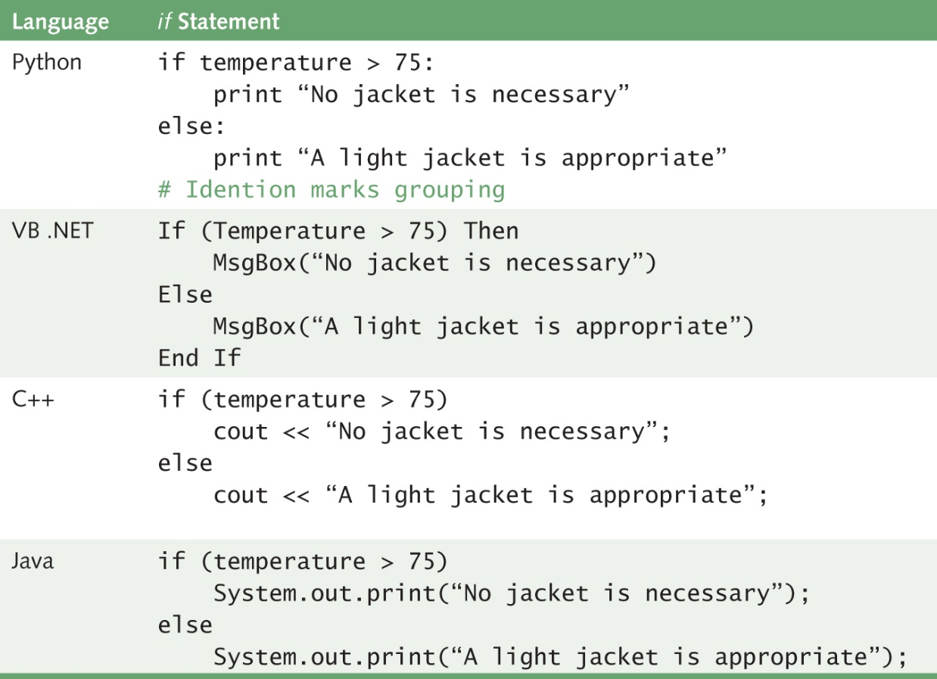
Selection Statements
The If statement allows the program to test the state of the program variables using a Boolean expression

Slide 63
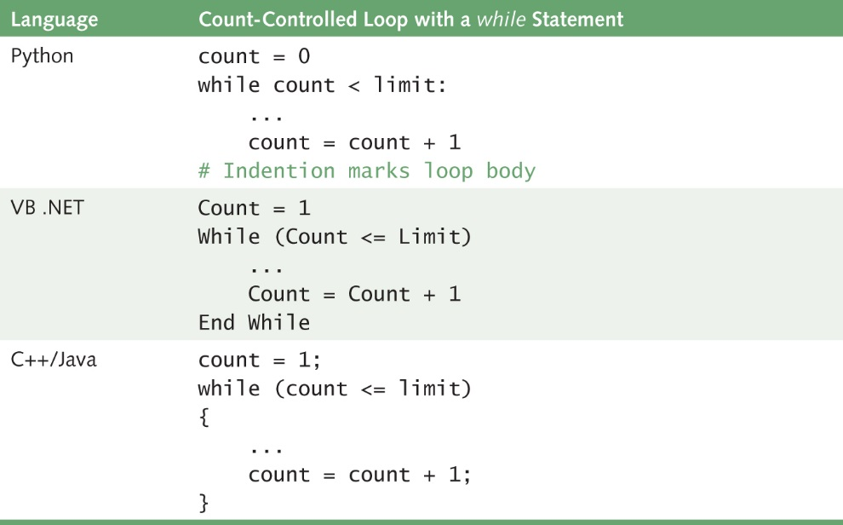
Looping Statements

Slide 64
Subprogram Statements (1 of 2)
We can give a section of code a name and use that name as a statement in another part of the program
When the name is encountered, the processing in the other part of the program halts while the named code is executed

Slide 65
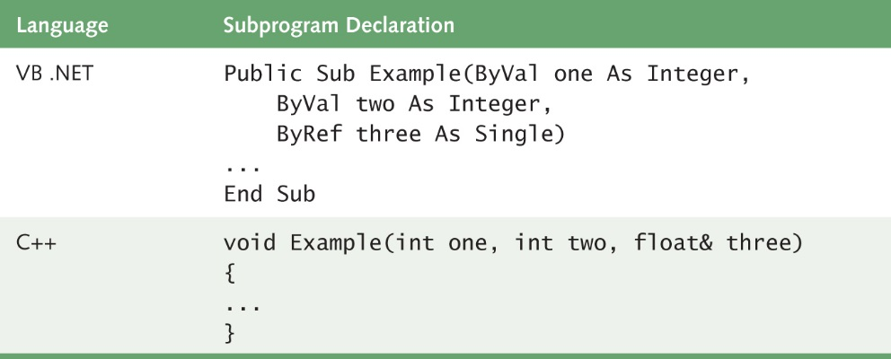
Subprogram Statements (2 of 2)

Slide 66
Nested Logic
Set sum to 0 // Initialize sum
Set posCount to 0 // Initialize event
WHILE (posCount <= 10) // Test event
Read a value
IF (value > 0) // Update event?
Set posCount to posCount + 1
// Update event
Set sum to sum + value
// Statement(s) following loop
IF within a WHILE
66
Notes:
66

Slide 67
Set weekCount to 1
WHILE (weekCount <= 52)
Set weekSum to 0
Set dayCount to 1
WHILE (dayCount <= 7)
Read rainfall
Set weekSum to weekSum + rainfall
Set dayCount to dayCount + 1
Write “Week” + weekCount + “total: ” + weekSum
Set weekCount to weekCount +
WHILE within a WHILE

Slide 68
Set weekCount to 1
WHILE (weekCount <= 52)
Set weekSum to CalculateWeekSum(weekCount)
Write “Week” + weekCount + “total: “ + weekSum
Set weekCount to weekCount +
CalculateWeekSum(weekCount)
…..
Which is easier to read?

Slide 69
Asynchronous Processing
Asynchronous Processing
Not synchronized with the program's action
Clicking has become a major form of input to the computer
Mouse clicking is not within the sequence of the program
A user can click a mouse at any time during the execution of a program

Slide 70
Functionality of OOPs (1 of 2)
Encapsulation
A language feature that enforces information hiding
Classes
Different meanings in different places (See next slide)
Inheritance
A property that allows a class to inherit the data and actions of another class
Polymorphism
An ability to handle the ambiguity of duplicate names

Slide 71
Functionality of OOPs (2 of 2)
Object Class (problem-solving phase)
An entity or thing that is relevant in the context of a problem
Object Class (Class) (problem-solving phase)
A description of a group of objects with similar properties and behaviors
Class (implementation phase) A pattern for an object
Object (implementation phase) An instance of a class
71
Notes:
71

Slide 72
Class Definition (1 of 5)
A class encapsulates both data and actions
public class Person // Name the class
// Declare Class variables
Name name
String telephone
String email

Slide 73
Class Definition (2 of 5)
// Declare Class Methods
Initialize() // Code for Initialize
public Print() // Code for Print
public Name GetName()
RETURN Name
public String GetEmail()
RETURN email
public String GetTelephone()
RETURN telephone
73
Notes:
73

Slide 74
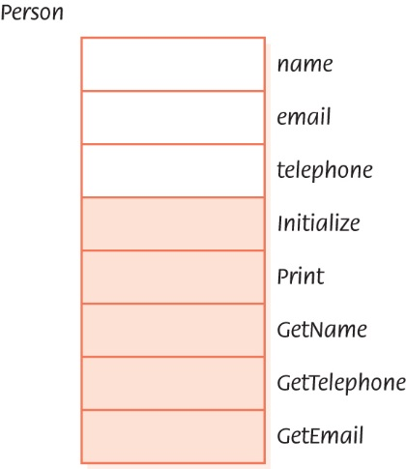
Class Definition (3 of 5)
Class Person
74
Notes:
74

Slide 75
Class Definition (4 of 5)
Name aName = new Name()
aName.Initialize("Frank", "Jones")
Person aPerson = new Person()
aPerson.Initialize(aName, telephone, email)
aPerson.Print()
Write "Name: ", aPerson.GetName().Print()
Write "Telephone: ", aPerson.GetTelephone()
Write "Email: ", a Person.GetEmail()
75
Notes:
75

Slide 76
Class Definition (5 of 5)
To get an object of a class, we must ask that one be created (instantiated). The new operator does this for us:
Person myPerson = new Person()
Student myStudent = new Student()
myPerson.Initialize(…)
myStudent.Initialize(…)
myPerson.Print()
myStudent.Print()
76
Notes:
76

Slide 77
Inheritance and Polymorphism (1 of 2)
Inheritance
A construct that fosters reuse by allowing an application to take an already-tested class and derive a class from it that inherits the properties the application needs
Polymorphism
The ability of a language to have duplicate method names in an inheritance hierarchy and to apply the method that is appropriate for the object to which the method is applied

Slide 78
Inheritance and Polymorphism (2 of 2)
Inheritance and polymorphism work together
How?
They combine to allow the programmer to build useful hierarchies of classes that can be put into a library to be reused in different applications

Slide 79
Top-Down versus OO Designs (1 of 2)
Top-Down Solution
Data structures needed in solution are determined
Subprograms are written to manipulate the the data structures
Main program declares data structure
Main program calls to the subprograms, passing data structures as parameters
79
Notes:
79

Slide 80
Top-Down versus OO Designs (2 of 2)
Object-Oriented Solution
ADTs needed in solution are determined
ADTs are written only if not in library
Data structure is encapsulated within the class that implements the ADT
Main program is instructions to ADTs to perform the necessary tasks
80
Notes:
80

Slide 81
Ethical Issues
Computer Hoaxes and Scams
What is the principal difference between a hoax and a scam?
What are the most common complaints of Internet users about computer scams and hoaxes?
What are the most serious crimes perpetrated on the Web?
Why is it so difficult to police these schemes?

Slide 82

Who Am I?
I am best known
for structured
programming.
Can you define it?
I am also known
for my wit. Can
you recall some
of my witty
sayings?
Courtesy of Staci Norman, UTCS, the Universtiy of Texas Austin

Slide 83
Do You Know?
How are computers used in tennis tournaments?
What does 78% of software downloaded from
websites and peer-to-peer networks contain?
What predated the functionality of Bytecode?
What does the word "paradigm" mean? How
has its meaning changed over time?
How many definitions can you think of for
"bow"?

